Slide 1
Austin Traffic Incident Analytics
Presenter: Jessica Chen
Notes:
Talk about my motivation towards this choice of topic

Slide 2
Overview
Goal: Analyze the effects of human activities on number of traffic incidents
QUESTIONS
To what extent is there a correlation between major events (holidays/breaks), and traffic incidents?
To what extent is there a correlation between big local events (ACL/UT football games) and traffic incidents?
Does the day of the week and the time of the day have an effect on traffic accidents?
RESOURCES
City of Austin - Travis County Traffic Report Page
Crash Records Information System (CRIS) Query
Notes:
Overview
Main questions I’m asking:
To what extent is there a correlation between major events, including holidays/breaks, and traffic incidents?
To what extent is there a correlation between big local events, such as ACL, UT football games, and traffic incidents?
Does the day of the week and the time of the day have an effect on traffic accidents?
Resources:
City of Austin - Travis County Traffic Report Page (http://www.ci.austin.tx.us/qact/default.cfm?sort=0&fbclid=IwAR3aLqXL88wekLL8vmXP_9vcw7hz9AnqwgfwaTtI7K7paCk1jyxyqqNkmkE): Only had a year’s worth of data, creating a really big limitation on the credibility on answering the questions regarding yearly local events in Austin such as ACL, so data extracting from this resource was used to analyze the correlation between the time/date and traffic incidents
Crash Records Information System (CRIS) Query (https://cris.dot.state.tx.us/public/Query/app/public/welcome?fbclid=IwAR1wT-qNXRq9wlNXbkmhSfBGozCL7LsmjhwuII2vJfclGXjfFqKMU3JSJik): CRIS had a greater quantity of data as it had traffic records since 2010. Although the City of Austin Traffic Report Page was useful, it was a collection of data via the live incident reports; on top of that, the City of Austin data set was very limited since it was from 2017 to 2018, so I tried to collect more data with that by analyzing traffic incidents instead of accidents. That being said, I was unable to collect data on the specific date of the incident with CRIS (only the year, time, and day of the week, etc.), so I used this data set to analyze the correlation between weather / day of the week / time of the day and traffic accidents

Slide 3
To what extent is there a correlation between major events (holidays/breaks), and traffic incidents?
1

Slide 4
Data Exploration
Extract Data
Jupyter Notebook
Matplot
1
2
3
Notes:
Extract: Data Download CSV data from City of Austin - Travis County Traffic Report Page
I used the pandas library to read data from those CSV files, I then performed some group by queries for the month and for the week. After that I plotted a point for each major event that is part of the data, for example, the month that is the start of school year, the month that is the end of the school year, the week of thanksgiving, the week of Christmas, etc.

Slide 5
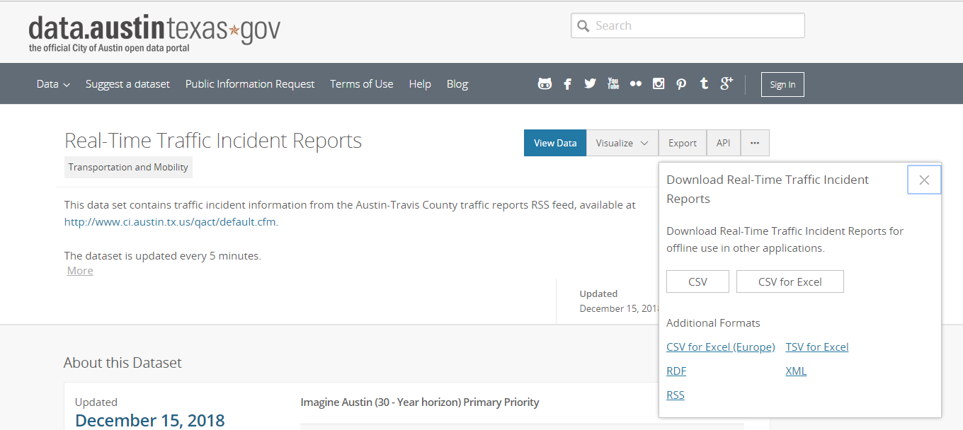
Data Extraction
Notes:
City of austin has this available data that is scraped from a live traffic viewer website. Sadly this data only goes back into late 2017 and does not provide much more than a description and a time of the incident. We exported a csv file for our code to read.

Slide 6
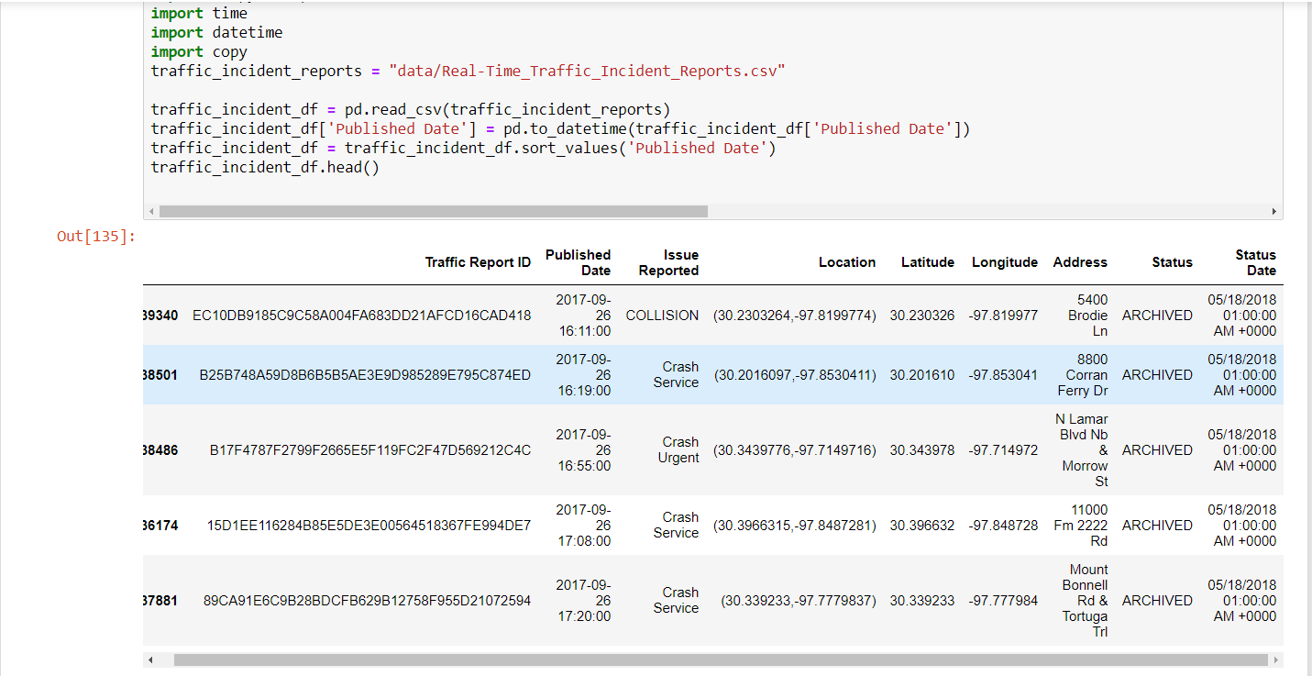
Raw Data
Data Import
Notes:
Traffic Report ID is probably an internal id, published date is when the incident was published, issue reported correlates to a code.
Copied directly from the City of Austin website:
I. Driver's Crash Report (Blue Form) - This report is completed by a driver involved in a traffic crash when the crash is not investigated by a law enforcement officer and apparent damage is $1,000 or more or when the crash resulted in injury or death. Visit the TXDOT website for more information.
II. Crash HS Hot Shot- Collisions that are blocking traffic on high speed roadways, and/ or require life-saving first-aid. Examples: Crashes with a high probability of serious injuries such as rollover, head-on, or very high rate of speed crashes. Collisions blocking High Speed Roadways. HSR (High Speed Roadways) are Interstates, US and State Highways to include frontage roads. Collisions on HSR that have been pulled to the shoulder and are no longer blocking are not a Hot Shot call.
III. Crash Service- Collisions that are not blocking or impeding traffic. Collisions having occurred on private property. Leaving the scene collisions where there are no injuries, lanes, blocked, or any parties chasing the other as a result of the collision.
IV. Crash Urgent- Collisions involving minor injuries and or where minor injuries are suspected. Collisions that are blocking secondary roadways (non-high speed). Collisions having occurred on a HSR (High Speed Roadway), but are no longer blocking (having pulled to the shoulder / parking lot)See Crash Service. Collisions involving city vehicles. Traffic Hazard Any traffic hazard on major thoroughfares that may cause a collision, injuries, or otherwise cause undue traffic congestion. For example: pedestrians, stalled vehicles, debris in the roadway, and / or inoperative traffic signals.
V. Traffic Impediment- Impediments located on minor roadways that do not pose an immediate hazardous situation; but if not addressed could cause future problems. For example: railroad arms stuck in the down position, stalled vehicles, and street parking issues that impede traffic.

Slide 7
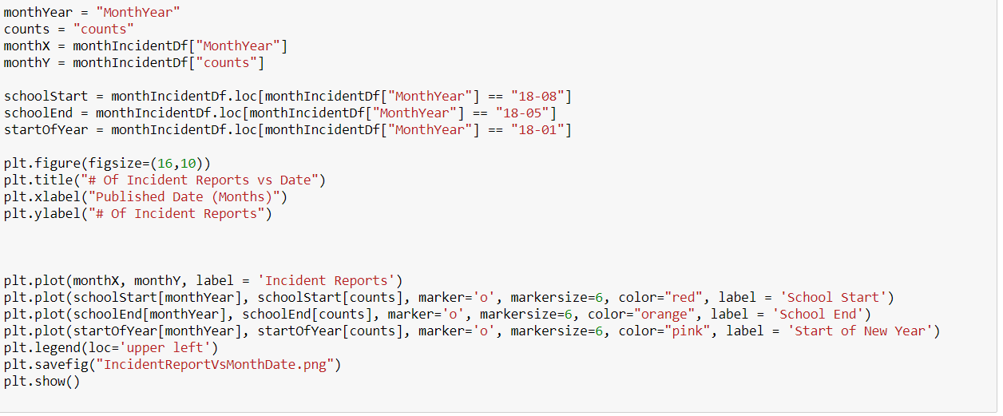
Plotting
Notes:
Here we see we get the x and y values for our plot from our data frame that has the incidents grouped by month and year. We also specifically plotted certain points such as school start or end so that people could see specific events we want to talk about. We use matplot to plot the data.

Slide 8
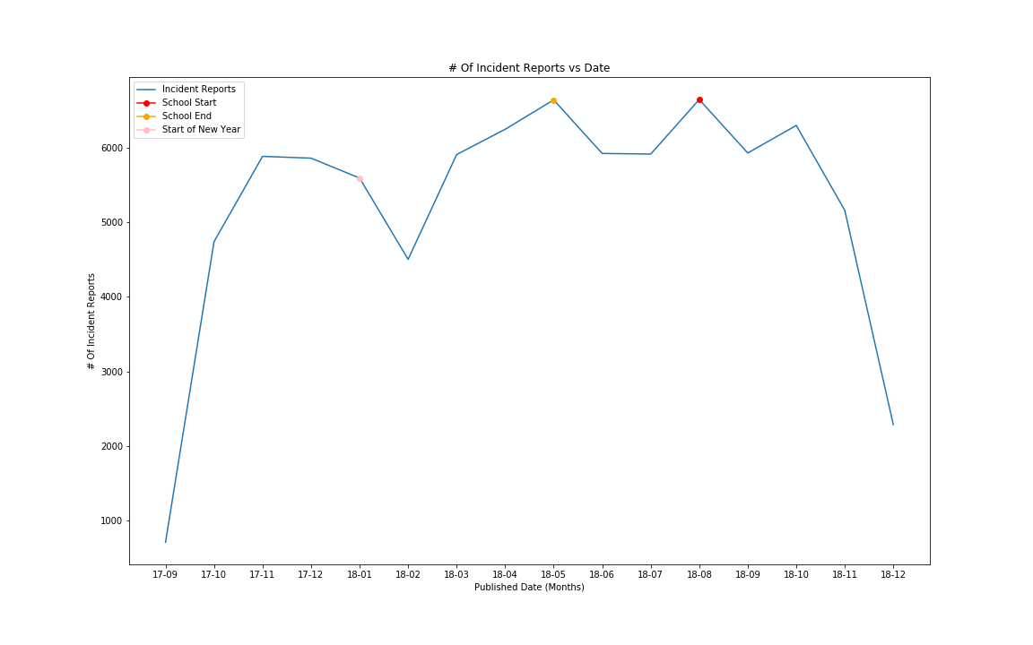
Notes:
Wait for answer page. Point out we are looking at School Start, End, and Start of New Year for a month.

Slide 9
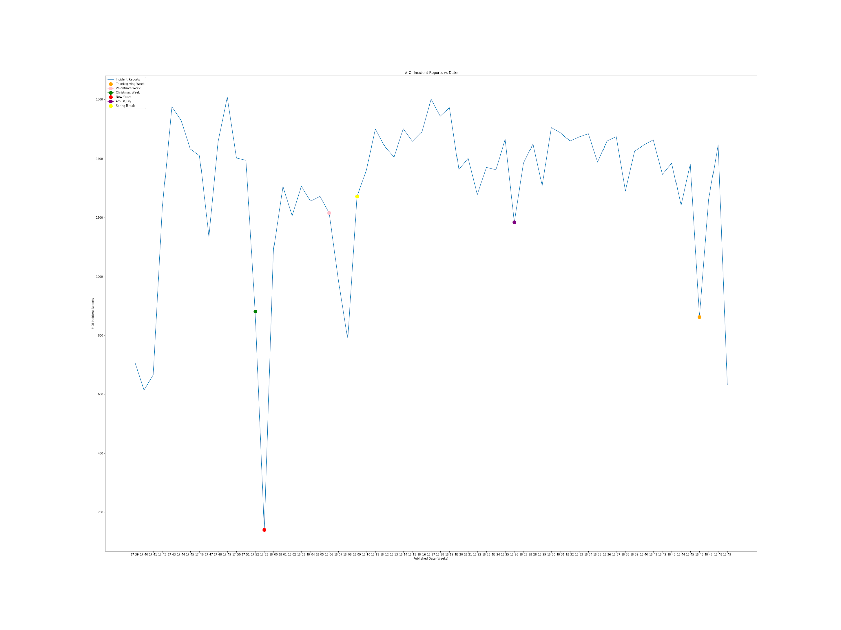
Notes:
Wait for answer page. We looked at some major holidays and notice how they correlate with the bottom spikes in the graph for a week.

Slide 10
Data Analysis
Notes:
Traffic incidents seem to reach their lowest number in February and spike in May and August when School starts and ends. There does seem to be a slight correlation with major breaks like when School starts or ends.
There does also seem to be a correlation between traffic incidents and major holidays. During the holidays there seems to be drops in incidents but before and after the holidays there are spikes.
Looking at the first plot over time, we can see from this year that the number of traffic incidents seem to fall and into their lowest number in February and spike back up after February. When school generally ends around May we see that the number of incidents seems to rise. This could be from all the people getting breaks from all sorts of schools and people leaving/coming to Austin during when school ends. We can see a noticeable drop in June, July as summer kicks in but when August comes around (School Start) we can see that the number of incidents shoots back up comparably to when school generally ends.
We also took a look closer into the given weeks throughout the year and measured the incidents. Here, we could see that on Christmas there was a sharp drop of traffic incidents and the sharpest drop when New Years approached. As the year starts back up there is an increase to normal levels until Valentines week which seems to show a drop after Valentines week and in between Spring Break week. We also notice a considerable drop on the week for 4th of July. The other drop we can see in traffic incidents is actually on Thanksgiving Week but there seems to be a sharp increase before and after Thanksgiving week as people move in and out of Austin.
So in conclusion there does seem to be a correlation between traffic incidents and major holidays. There also seems to be some relationships with some major breaks like when School generally starts or ends.

Slide 11
To what extent is there a correlation between big local events (ACL/UT football games) and traffic incidents?
2

Slide 12
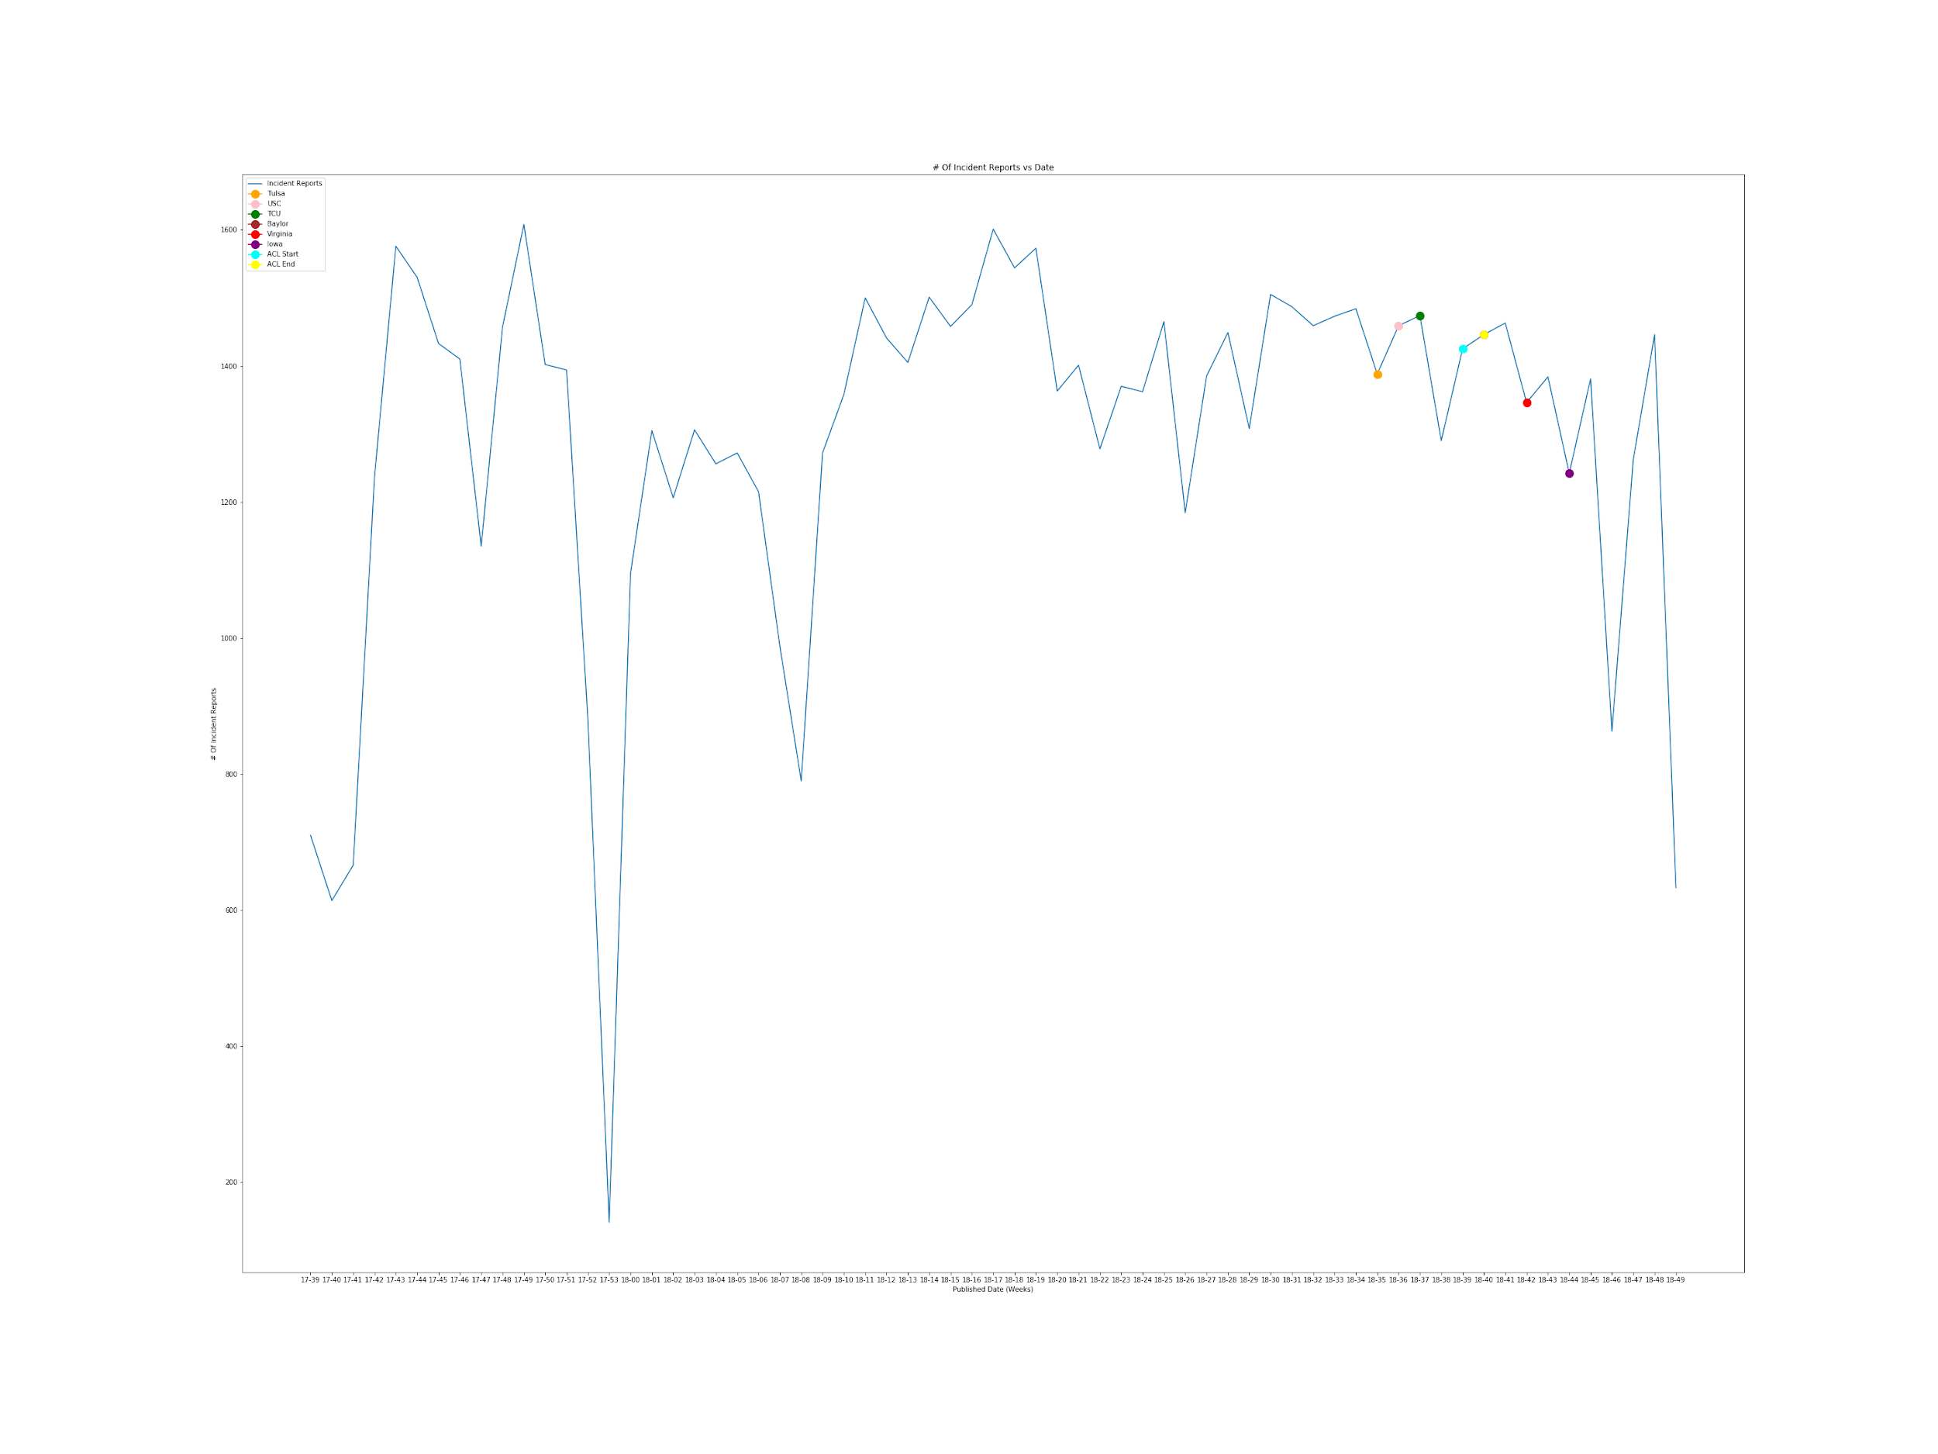
Notes:
This is number of incident reports over a week and we look into the football games and ACL.
X-axis: weeks between late 2017 to now
Y-axis: number of incidents

Slide 13
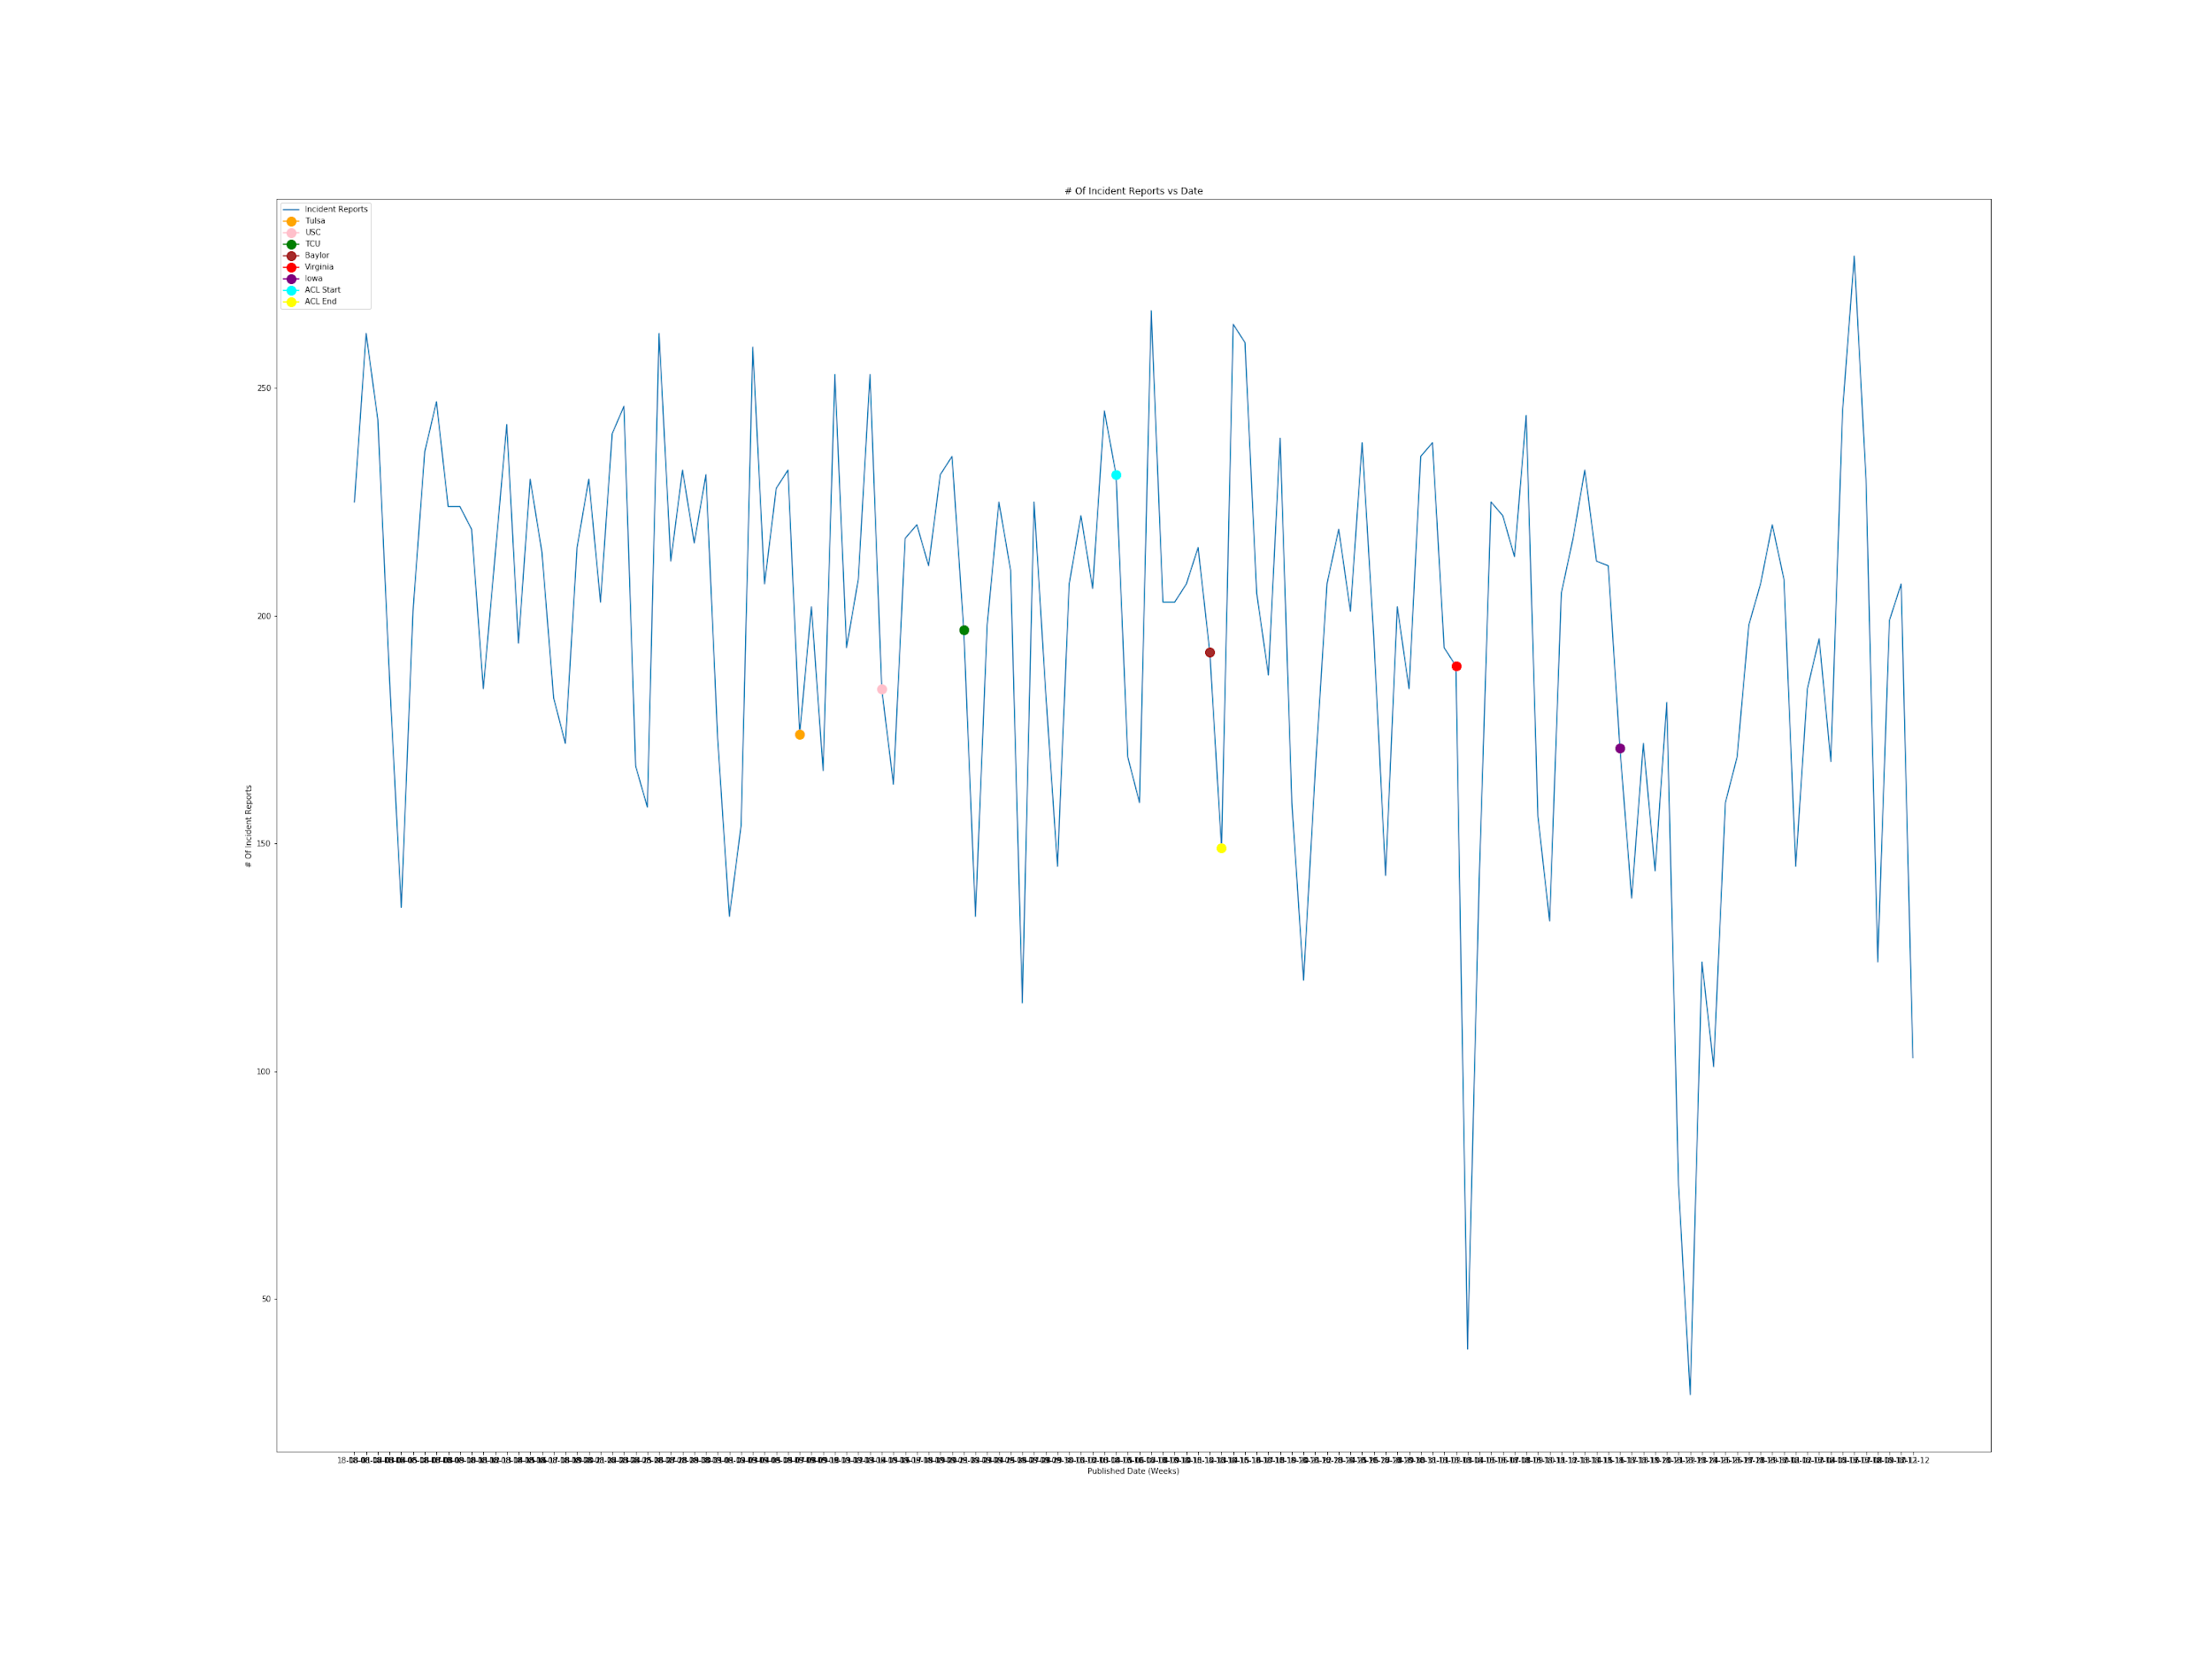
Notes:
We plot the data for only given days after August. If we plotted every day for entire year it would not look pretty.
X-axis: Days after August
Y-axis: number of incidents

Slide 14
Data Analysis
Notes:
The number of traffic incidents occurring around a football game and ACL only affected the number of traffic incidents reported to a small extent--according to the data, there are only around 10 to 20 more traffic incidents

Slide 15
Does the day of the week and the time of the day have an effect on traffic accidents?
3

Slide 16
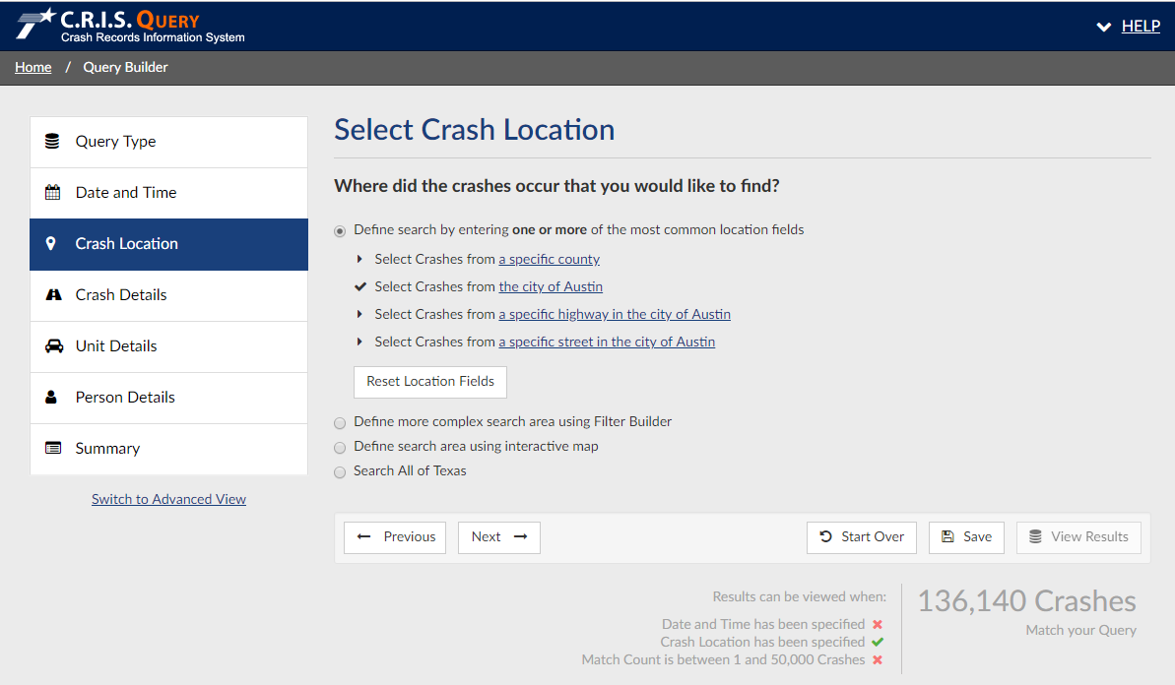
Data Extraction
Notes:
Discuss how CRIS (Crash Records Information System) provides a website that you can actually build a query using some checkboxes and some pages.
Once I selected the city of Austin as the crash location, I was also able to specify the range of years to export.
I had to only select the years 2010-2012 in the beginning because CRIS only allows you to export 50K crashes at a time, so I had to export that file and make separate queries for the remaining years up to 2018.
Additionally, I had the option to export over 60 properties, but I only exported the properties I was using for the project--including but not limited to city, crash severity, crash time, speed limit, weather, vehicle color.

Slide 17
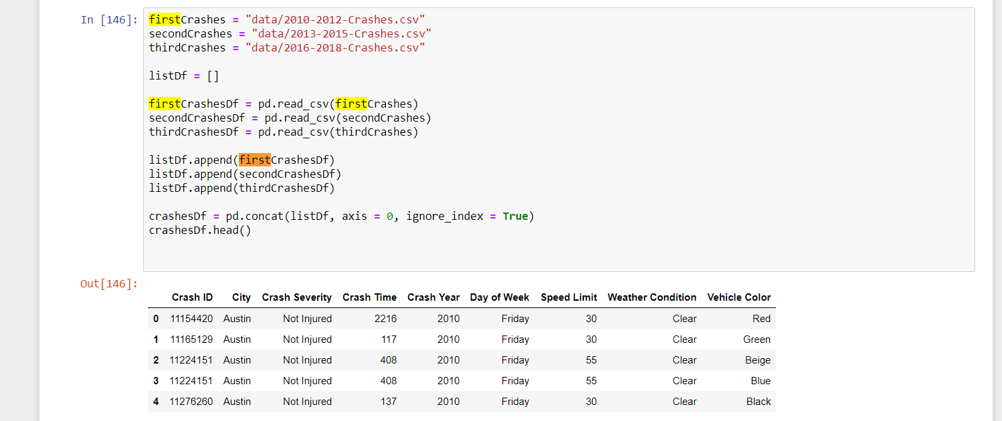
Raw Data

Slide 18
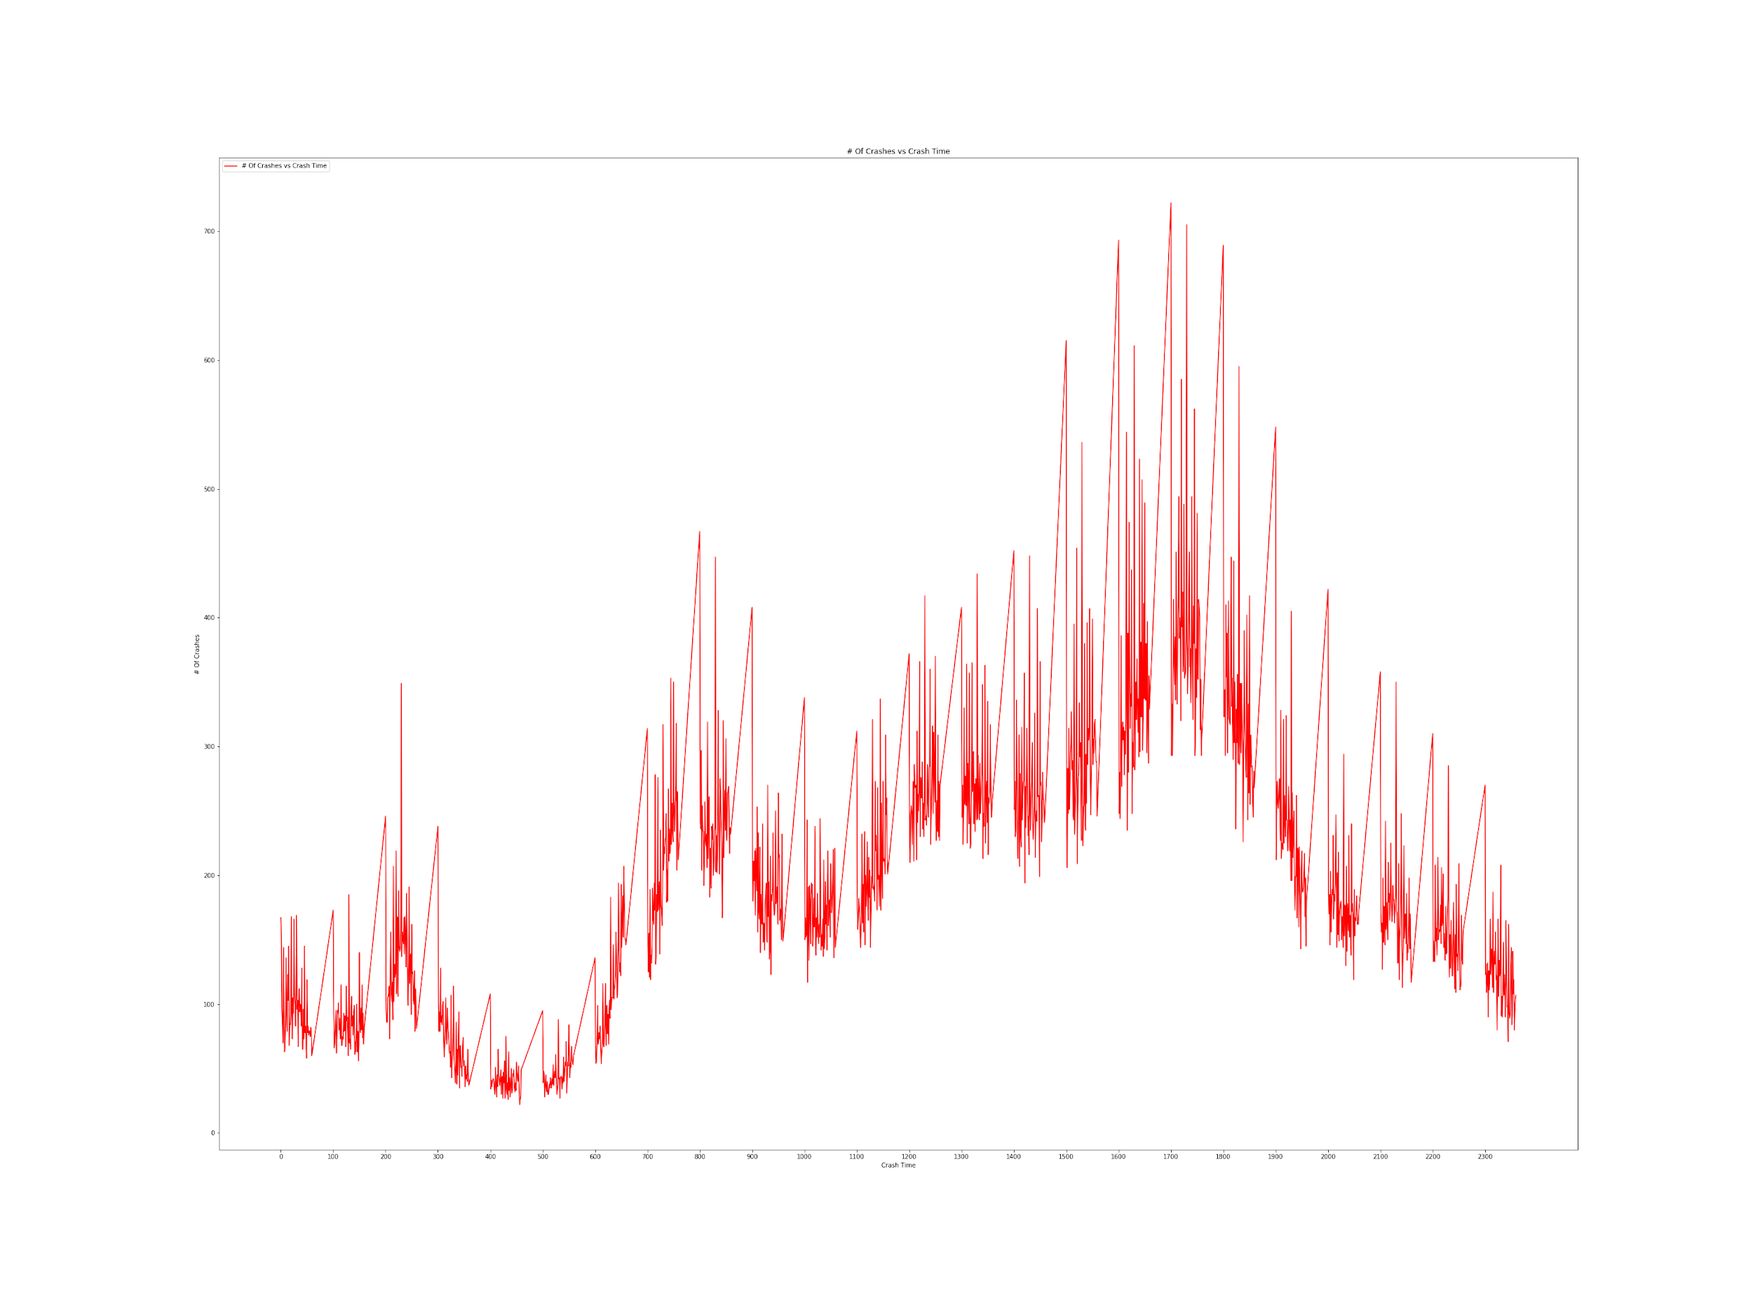

Slide 19
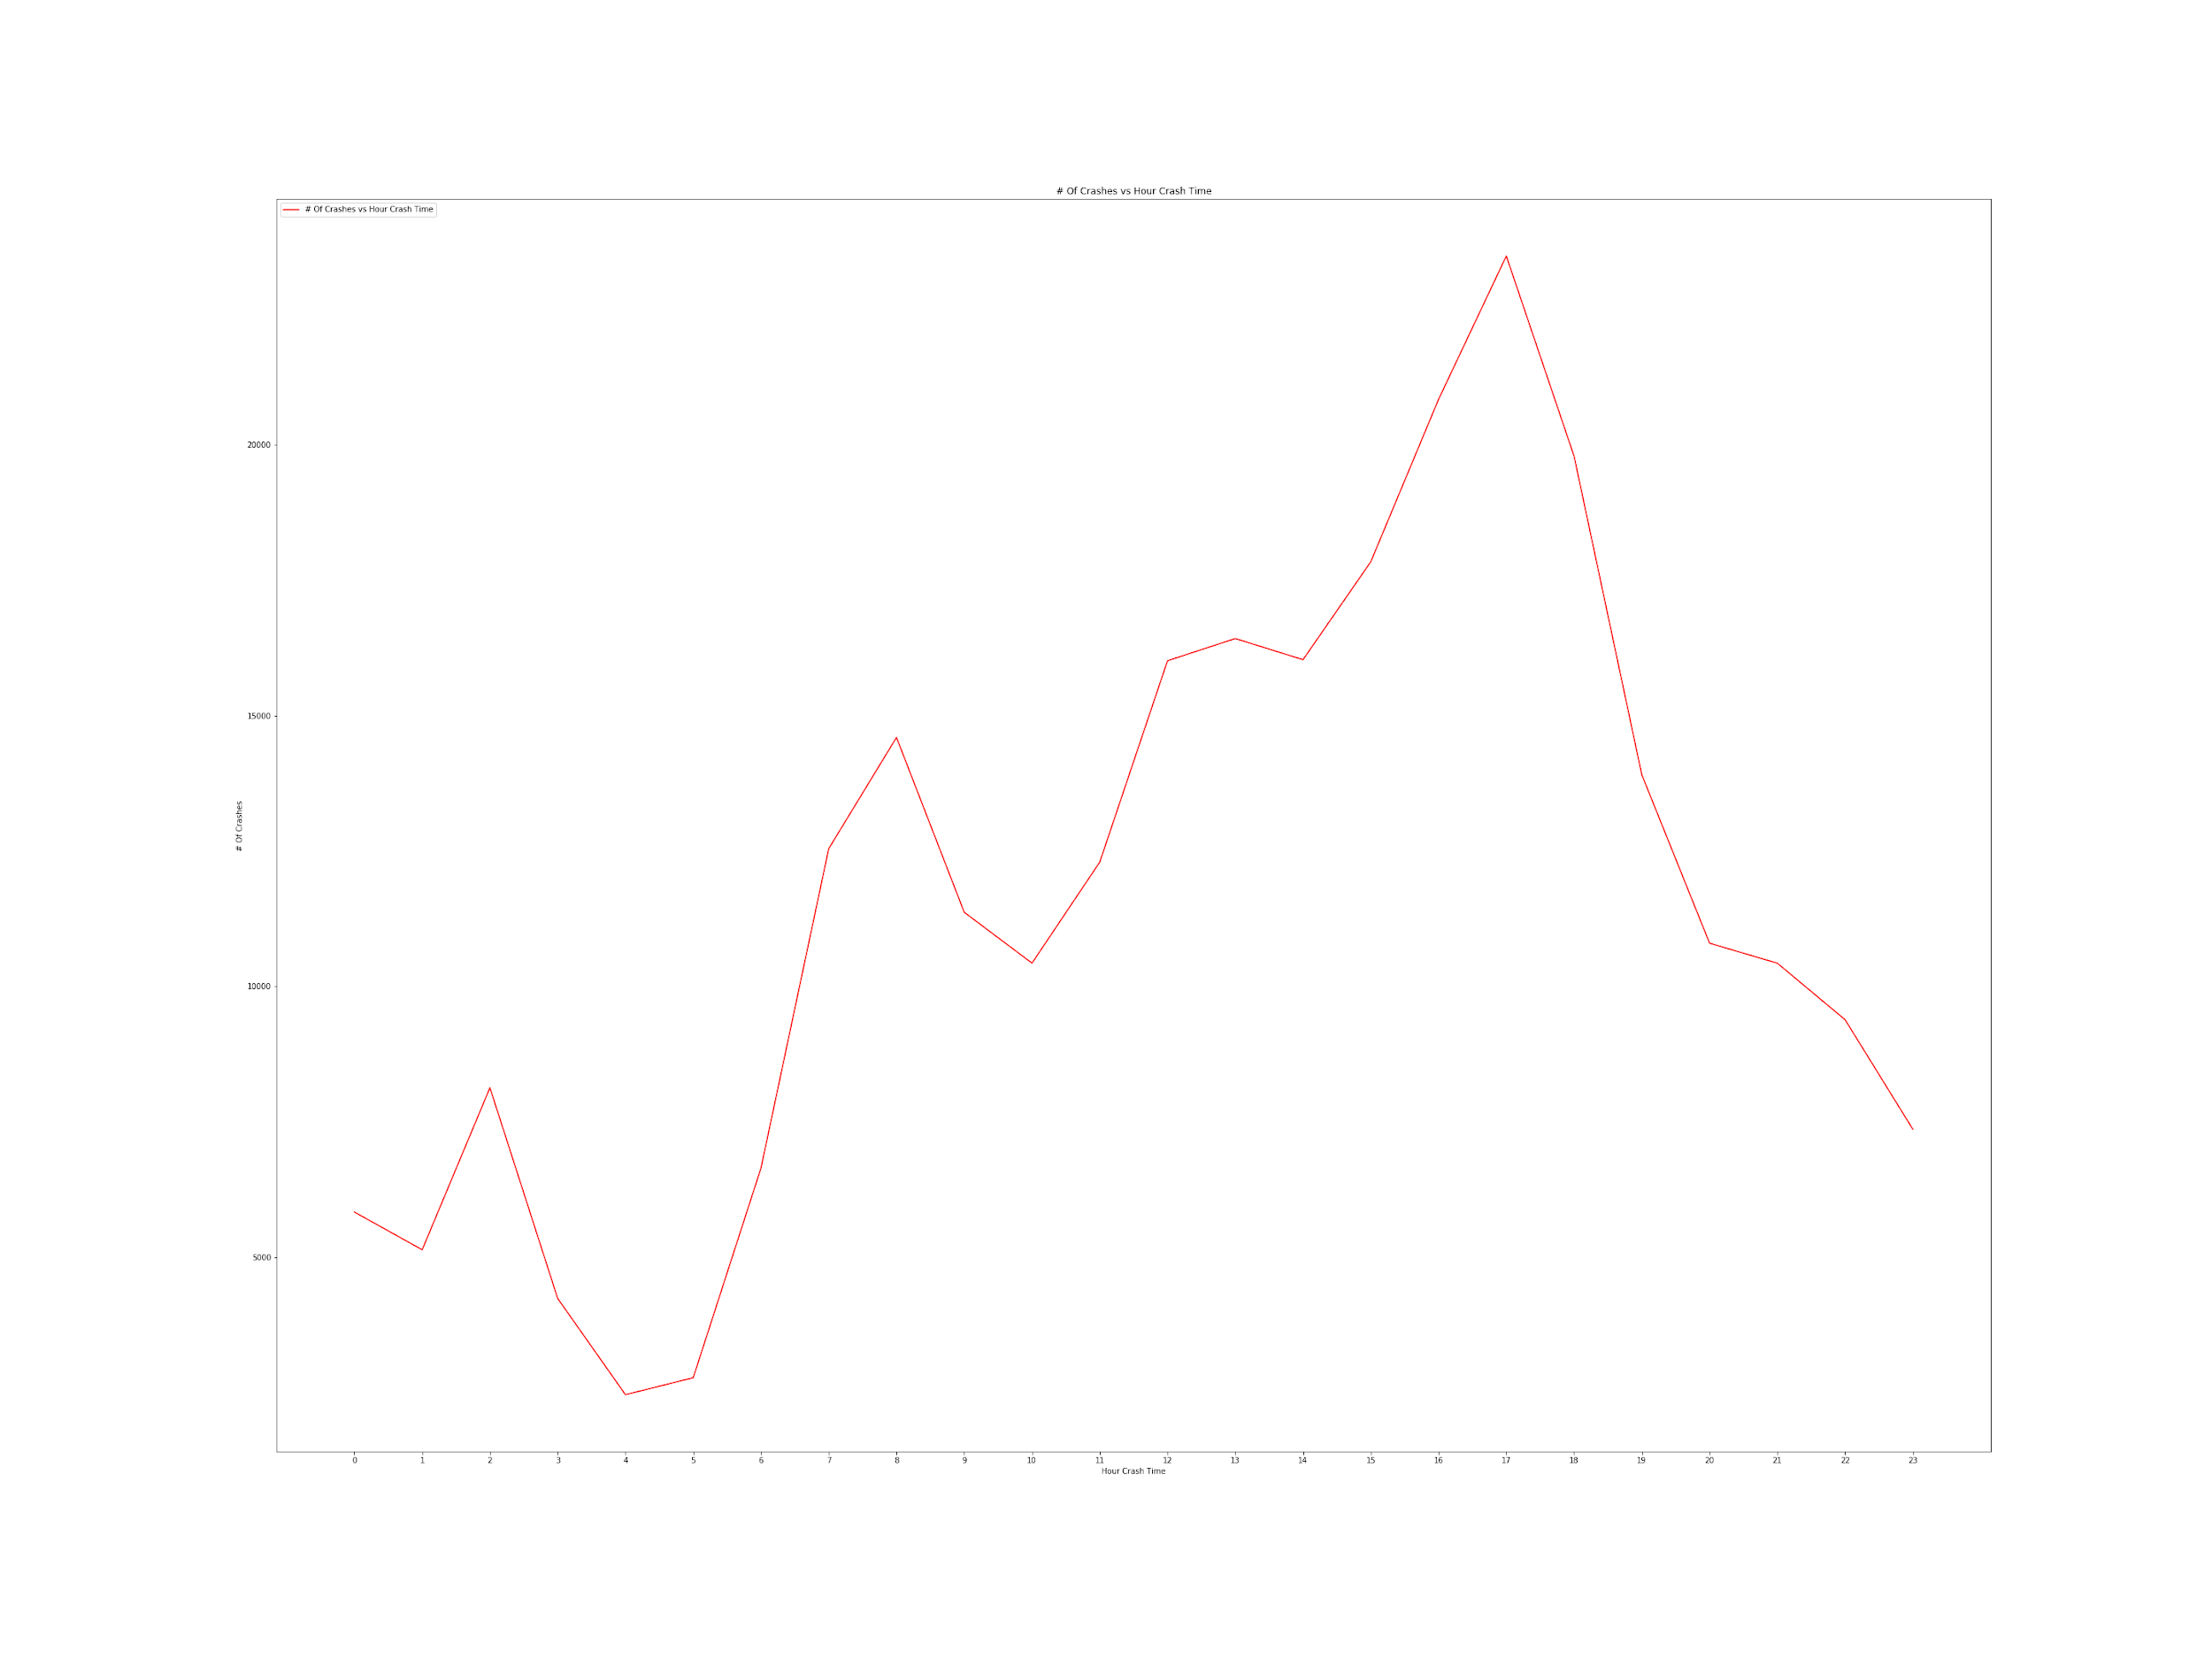

Slide 20
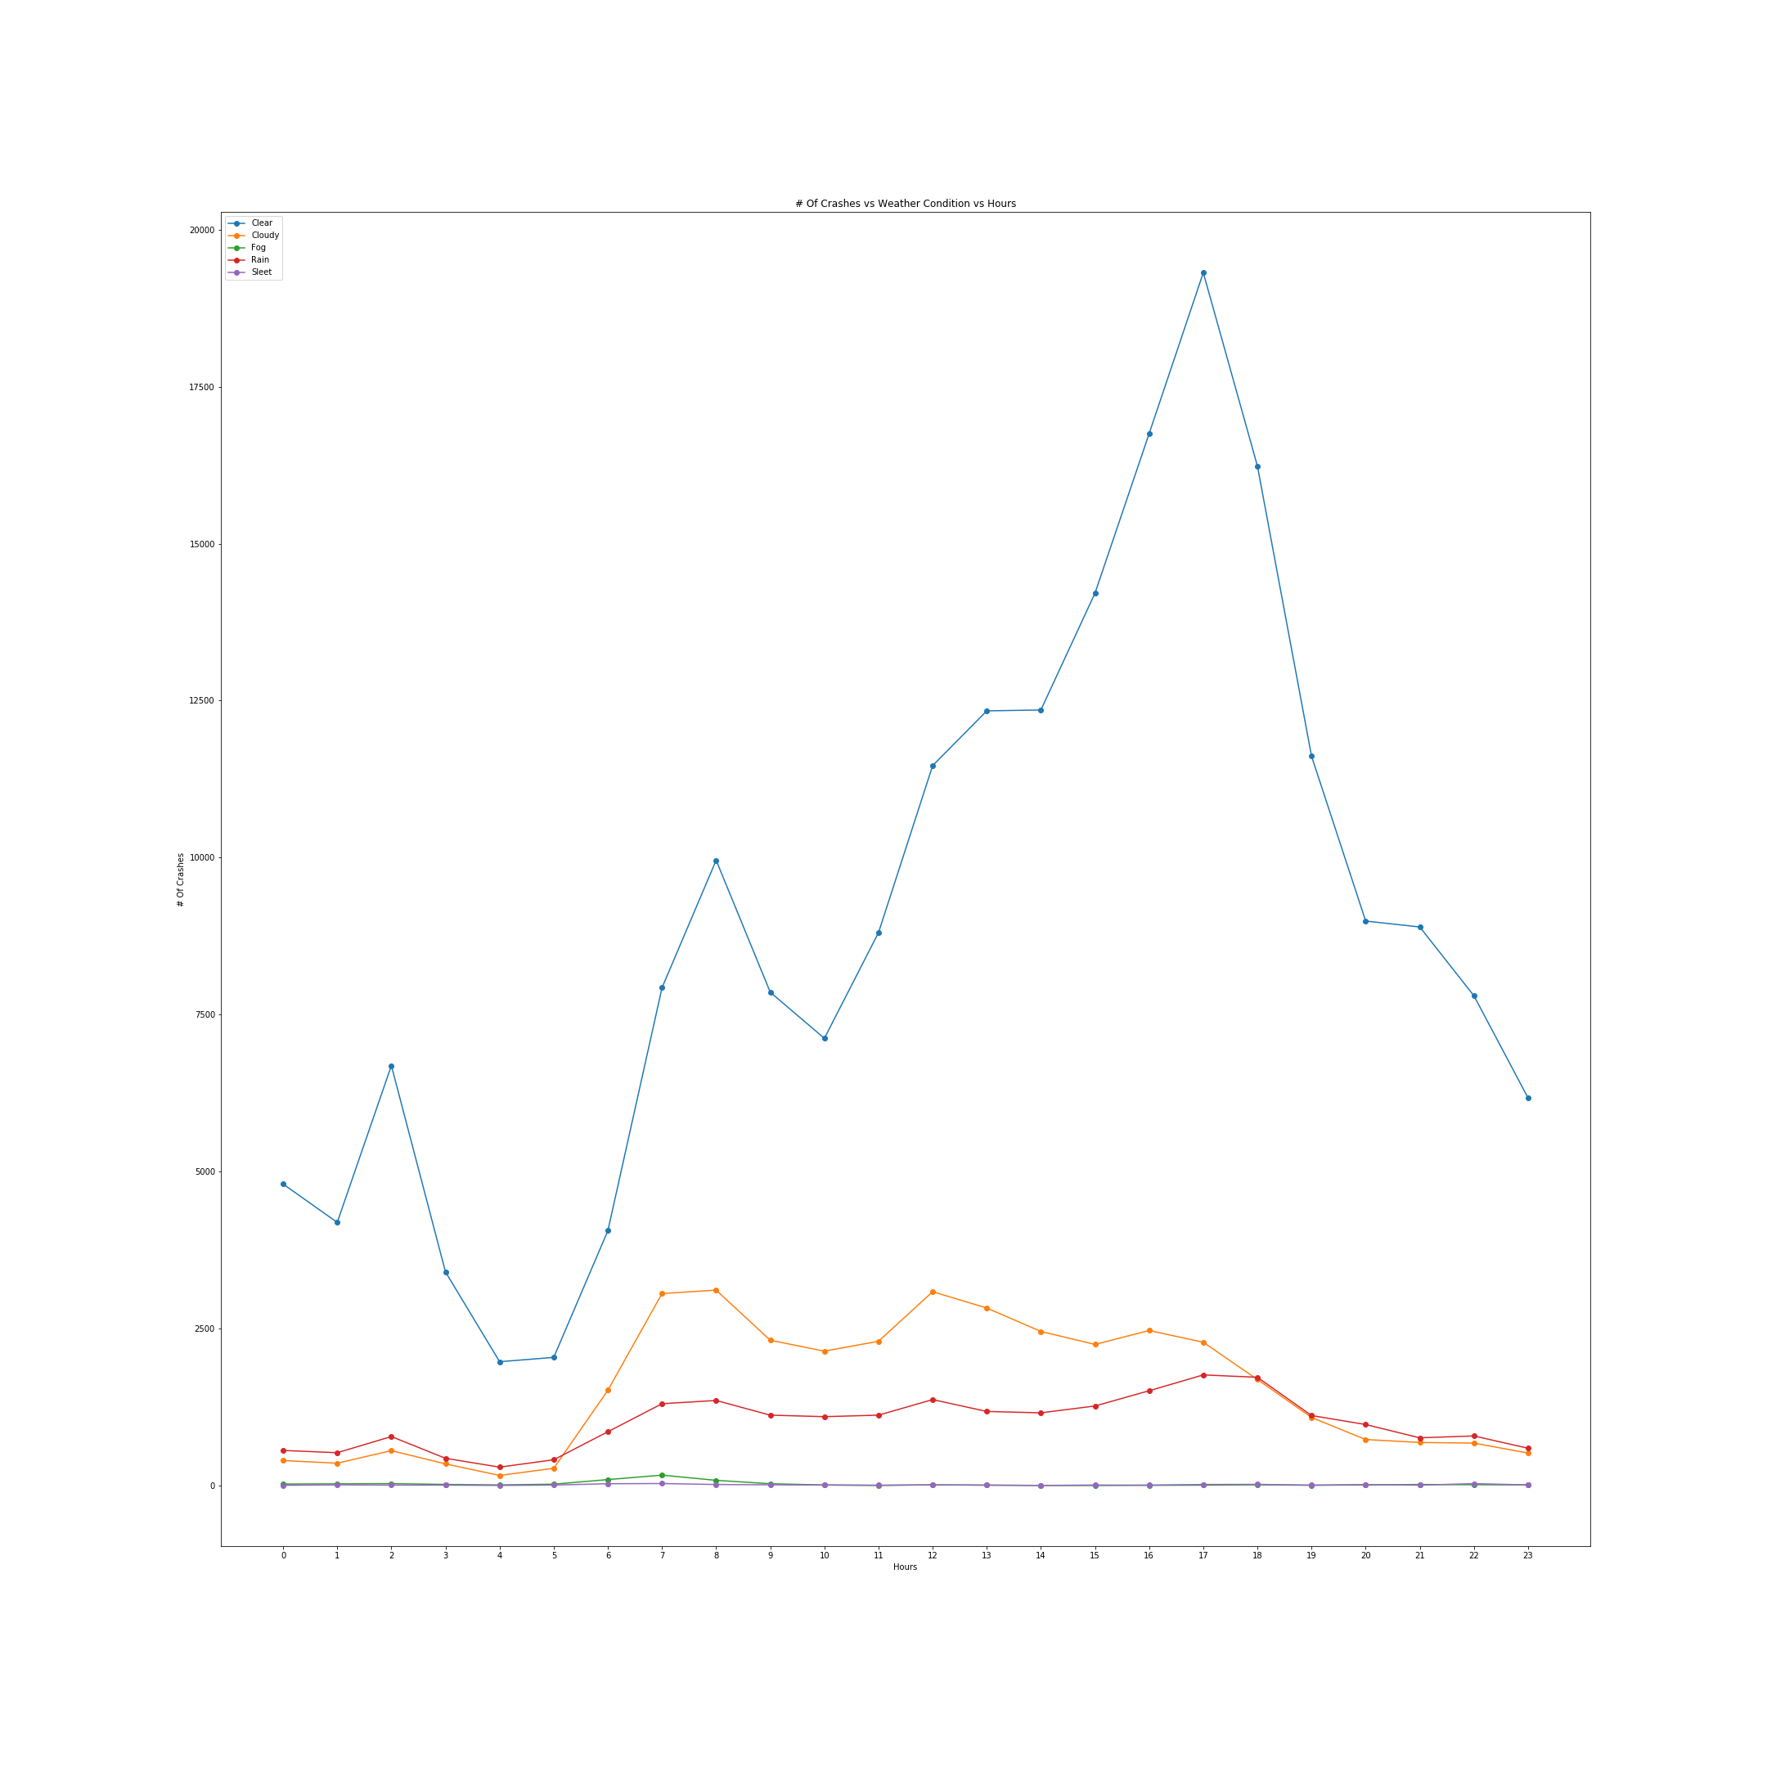

Slide 21
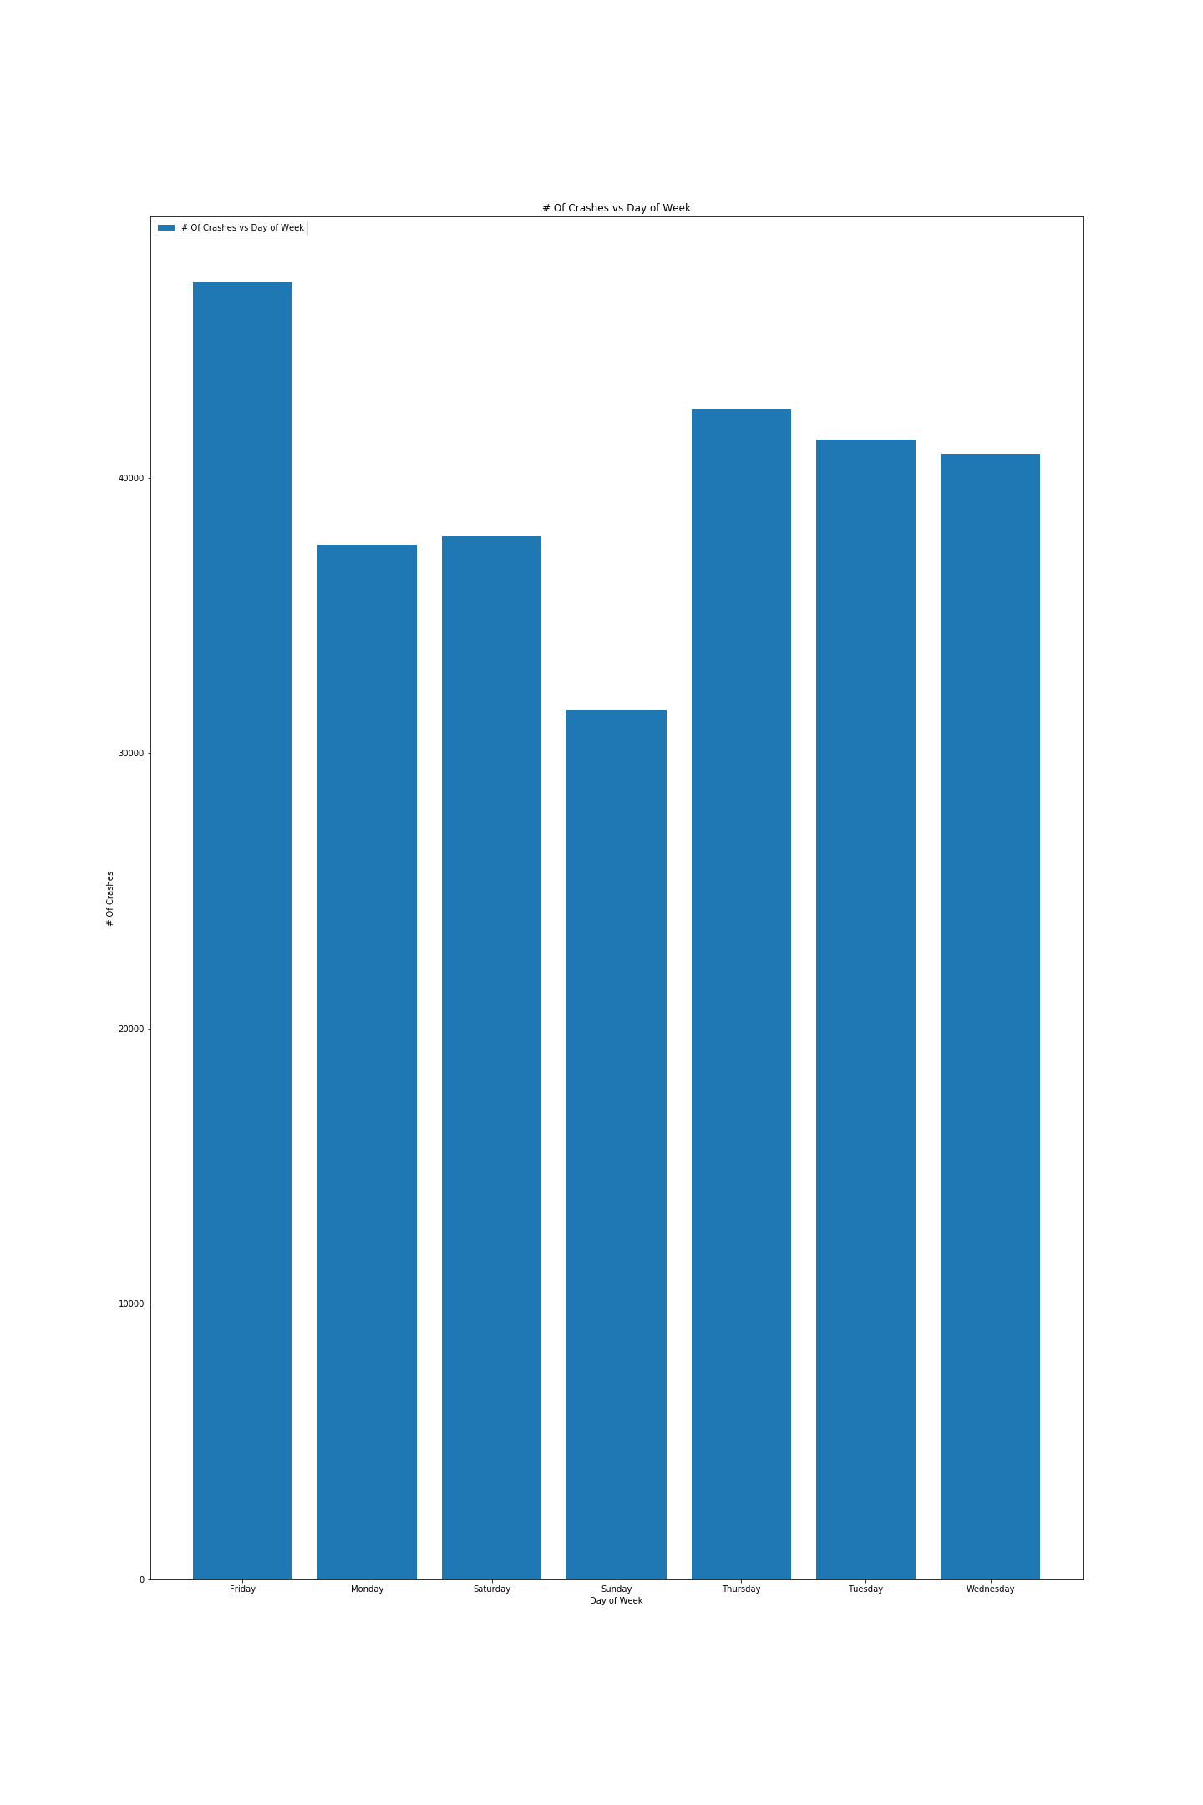

Slide 22
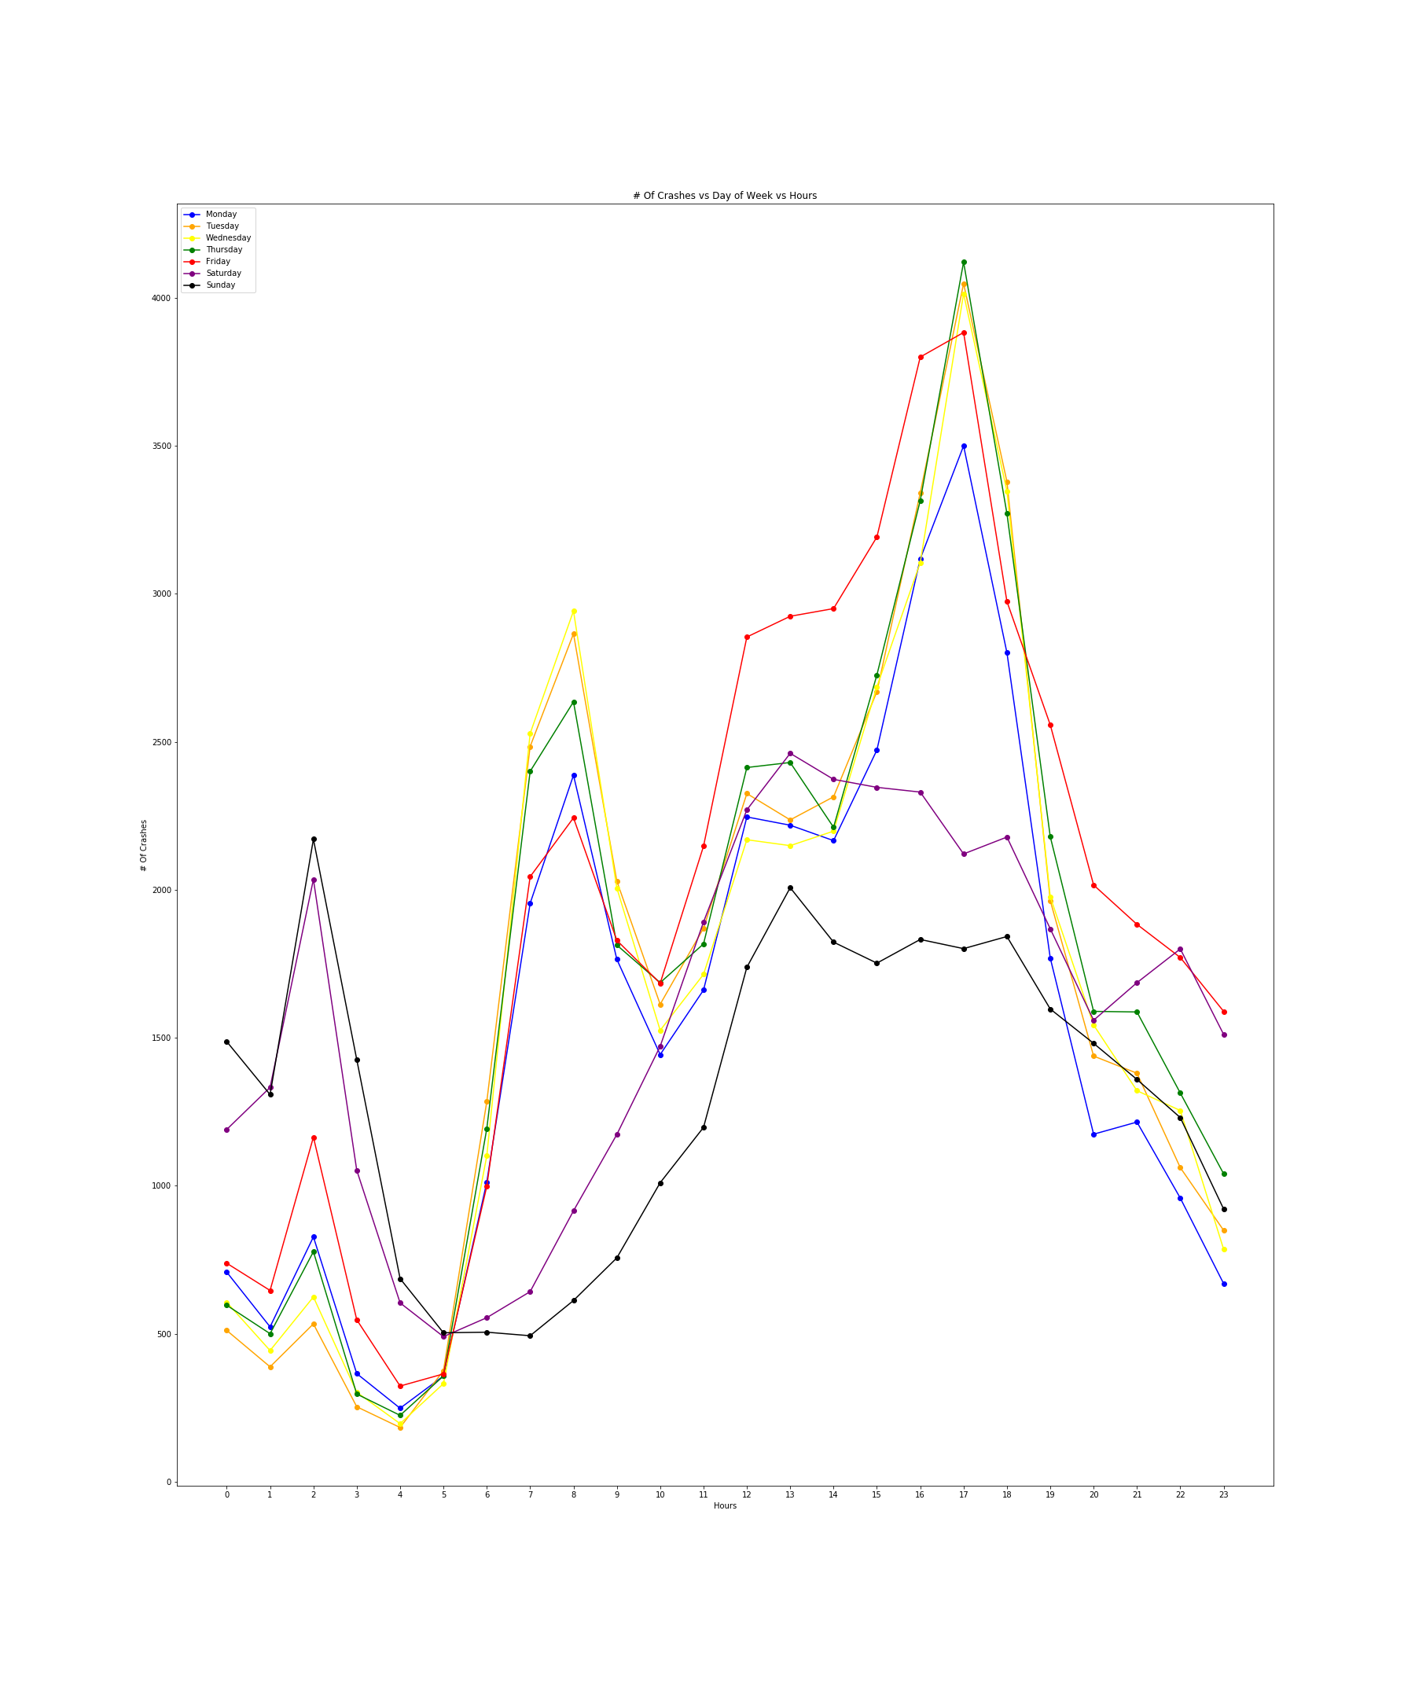

Slide 23
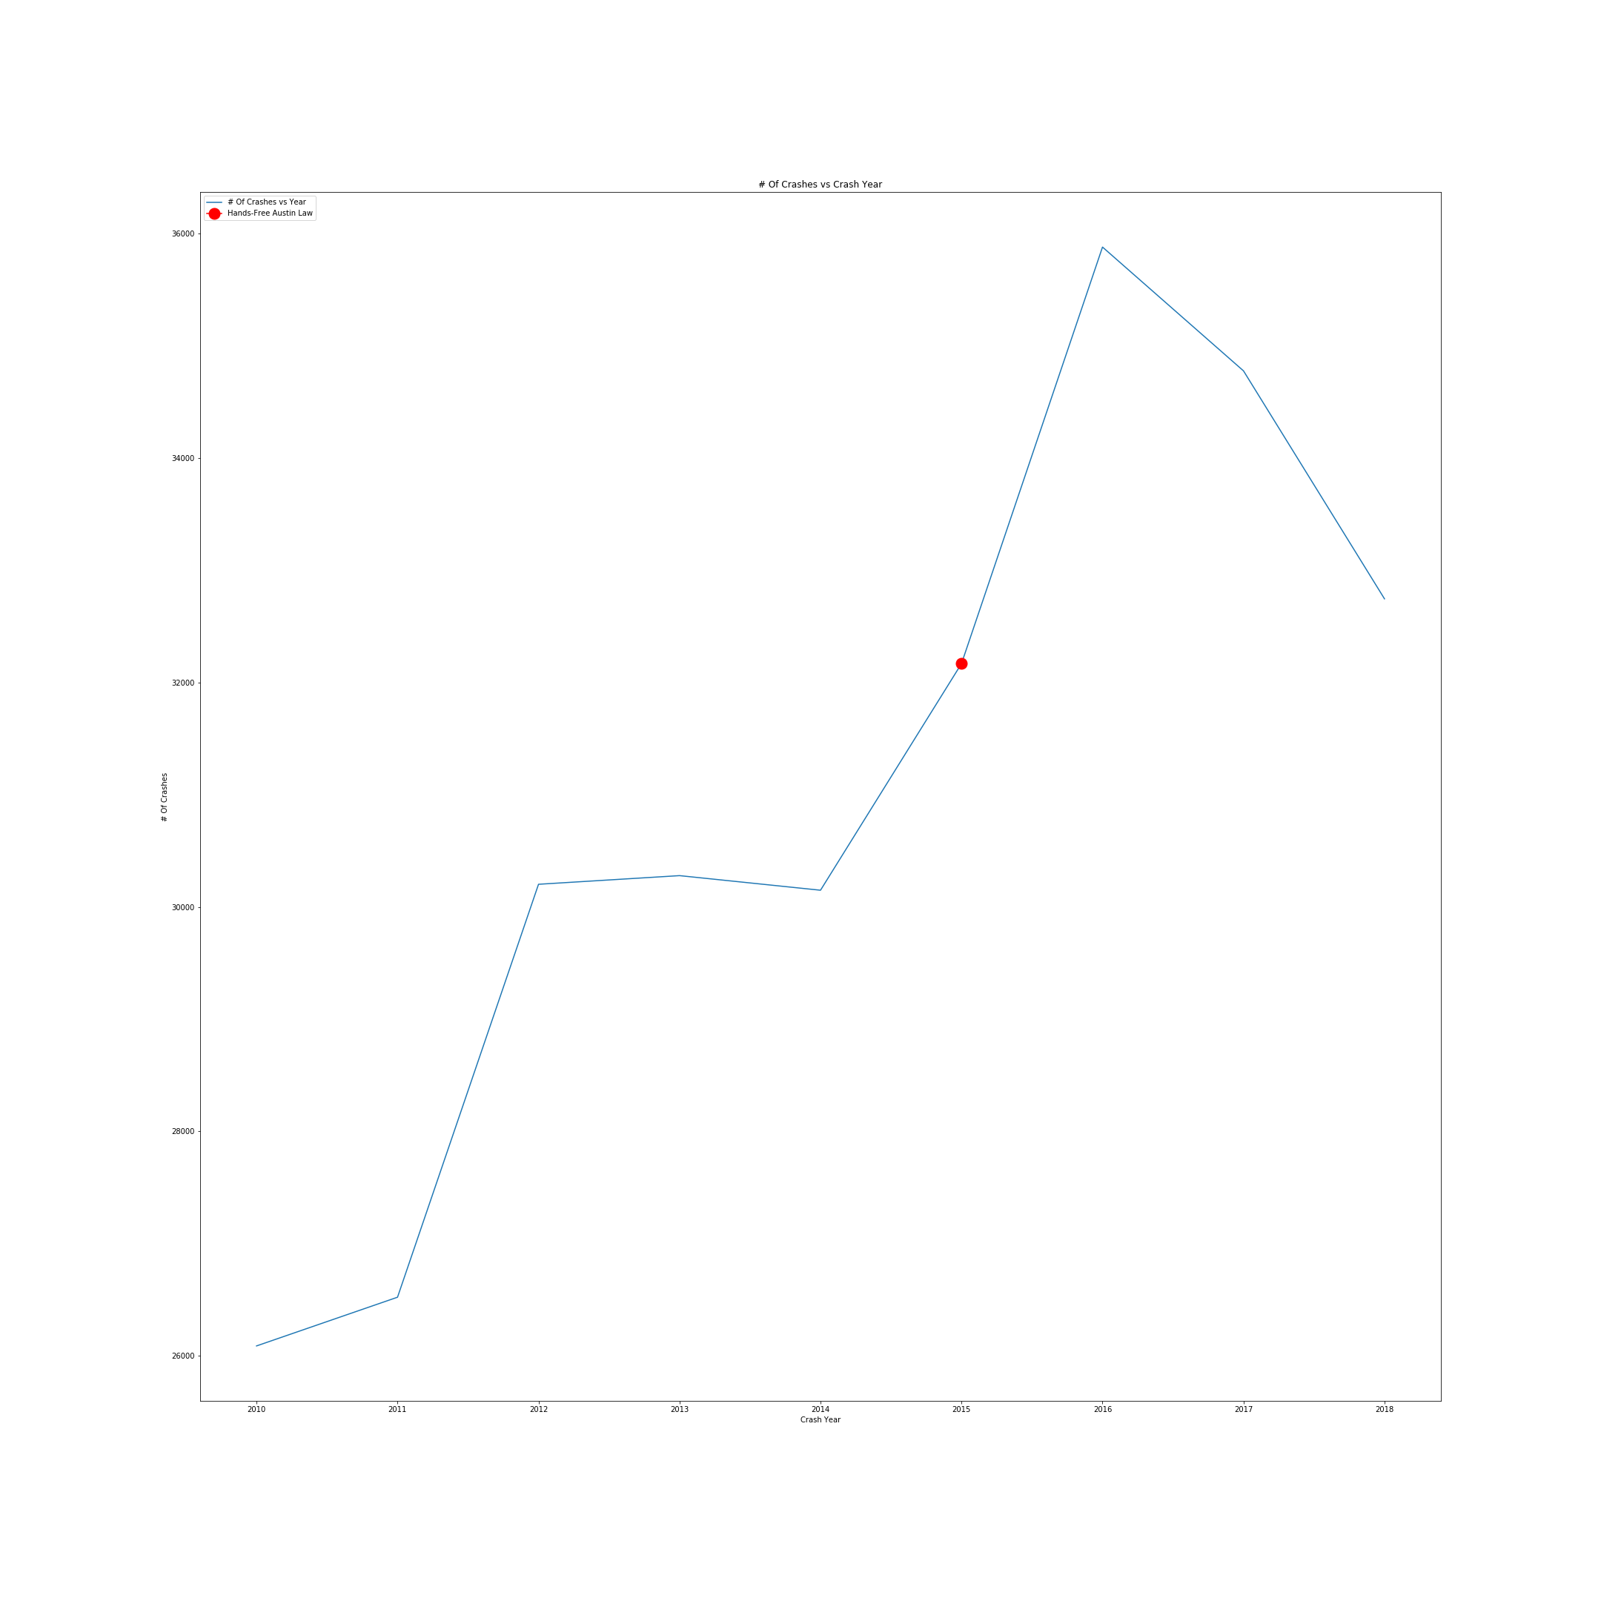

Slide 24
Data Analysis
Notes:
Crashes in Austin happen the least on Sunday and the most on Friday
Crashes tend to happen around 2 in the morning of Saturday and Sunday more than any other day. Monday-Friday has the most crashes in the morning around 7-8 and around 4-5. (2 AM actually has a spark of crashes constantly no matter how you look at the data. 2 am is when bars are required to close. Around 7 and 8 in the morning is when there are considerable spikes as people start to drive to work and 4-5 is when people generally leave work.)
There is correlation with the time and the number of accidents in Austin

Slide 25
Let’s Review!
To what extent is there a correlation between major events (holidays/breaks), and traffic incidents?
Traffic incidents reach their lowest number in February and spike in May and August. Because of this, there does seem to be a correlation with major breaks like when school starts/ends
There does also seem to be a correlation between traffic incidents and major holidays. During the holidays there seems to be drops in incidents but before and after the holidays there are spikes
To what extent is there a correlation between big local events (ACL/UT football games) and traffic incidents?
The number of traffic incidents occurring around a football game and ACL only affected the number of traffic incidents reported to a small extent--according to the data, there are only around 10 to 20 more traffic incidents
Does the day of the week and the time of the day have an effect on traffic accidents?
It does. Crashes in Austin happen the least on Sunday and the most on Friday. Additionally, crashes tend to happen around 2 in the morning of Saturday and Sunday more than any other day. Monday-Friday has the most crashes in the morning around 7-8 AM and around 4-5 PM

Slide 26
After Thoughts
Notes:
Less data from ATX meant me finding CRIS
Disappointing to not get date time from CRIS website.
So many fields to filter and correlate with from data set for CRIS
ATX city live traffic data helpful but has less data with the incident
If had more time would have considered other factors such as make of car, age, DUI all which CRIS has.
When I was trying to originally figure out what questions would be worth answering, I had to look at different attributes, including weather condition, speed limit, but I didn’t see much correlation within Austin. Although I did notice that white, black and silver cars had the most traffic incidents, it was difficult for me to take that data into consideration because those are the most common vehicle colors. CRIS also collected data on very uncommon vehicles such as camo, however there wasn’t enough data within Austin to calculate a relative percentage of car color and traffic incidents.

Slide 27
Thanks!
Any questions?
You can find me at
@jaybrans
jyc598@utexas.edu

